Slide 1
GRAPH
ALGORITHMS
Group 2
Selvira Junita Melia (U1921926L)
Glenda Hong Zixuan (U1921784A)
Chia Jia Tian (U1921632K)
Ernest Ang Cheng Han (U1921310H)
Tan Wee Li (U1922935K)

Slide 2
INTRODUCTION
01
TIME & SPACE COMPLEXITY
02
TABLE OF CONTENTS
03
EMPIRICAL ANALYSIS
04
DEMO

Slide 3
01
INTRODUCTION

Slide 4
ALGORITHM USED
Breadth-First Search

Slide 5
Breadth-First Search
1
0
Node 0 being the source node
Algorithm iterates in numerical order
1
2
3
4
5
Explores all neighbouring nodes at present depth level before moving onto next depth level.

Slide 6
02
TIME AND SPACE COMPLEXITY

Slide 7
TIME COMPLEXITY
Part (a) & (b)
Analysis | Algorithm starts the search from the source node, traversing n number of nodes and m number of edges before successfully finding a hospital node.
Calculation | Best Case | Average Case | Worst Case
 | Hospital node is only 1 edge away from source node O(1) | The algorithm traverses n/2 nodes and m/2 edges before finding hospital node O(n/2 + m/2) = O(n+m) | Each while loop will process each edge once, for a total cost of m. Each node is queued and dequeued costing n. O(n+m)

Slide 8
TIME COMPLEXITY
Part (c) & (d)
Analysis
First hospital node reached. Path is returned as output.
Hospital node reclassified as normal node.
Algorithm does another BFS to find the next nearest hospital node.
Repeat step 1-3 k number of times, k being the number of hospitals to search for each source node.

Slide 9
TIME COMPLEXITY
Part (c) & (d)
Best Case
Source node in the graph has k number of hospital nodes only 1 edge away, and current nearest hospital is removed.
O(k(1+1) ) = O(k)

Slide 10
TIME COMPLEXITY
Part (c) & (d)
Average Case
Algorithm traverses through n/2 nodes and m/2 edges and removes the nearest hospital node once for each BFS search.
O(k*[(n/2)+(m/2)+1]) = O(k(n+m+1))

Slide 11
TIME COMPLEXITY
Part (c) & (d)
Worst Case
Algorithm has to traverse the maximum number of nodes n and edges m for first hospital search.
Each node is queued and dequeued once, costing n time.
Each edge is also processed once per search, costing m time.
The nearest hospital node is removed.
BFS carried out k times.
O(k(n+m+1))

Slide 12
SPACE COMPLEXITY
Algorithm requires O(n) space to store n number of nodes.
(a) & (b): O(m) needed to store path source node takes to nearest hospital node.
(c) & (d): O(mk) needed to store paths to number of hospitals k

Slide 13
03
EMPIRICAL ANALYSIS

Slide 14
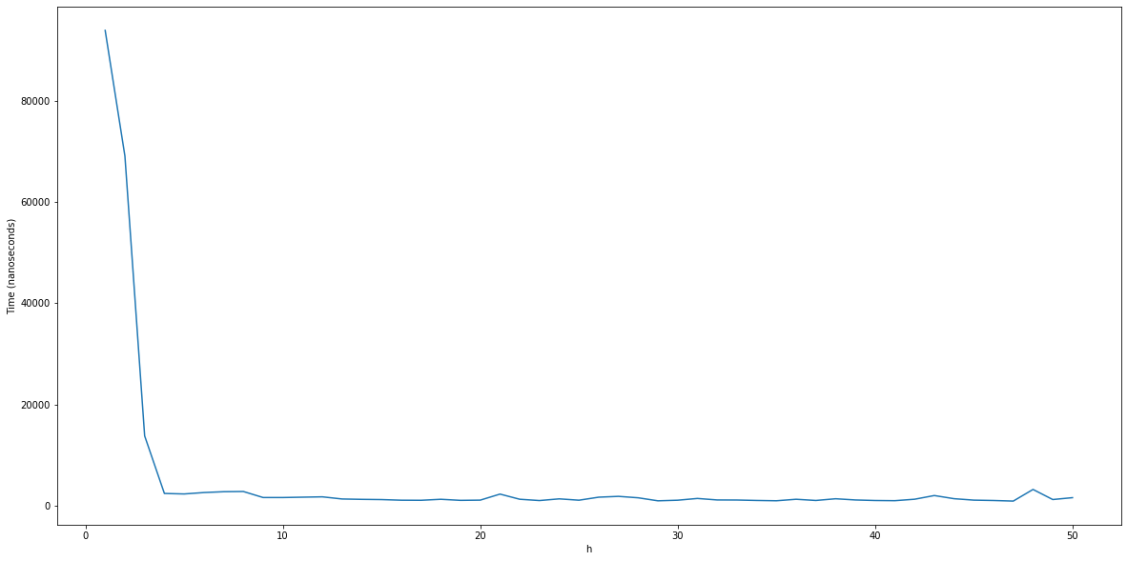
Effect of h on runtime (Part a & b)
Time Taken
Value of h

Slide 15
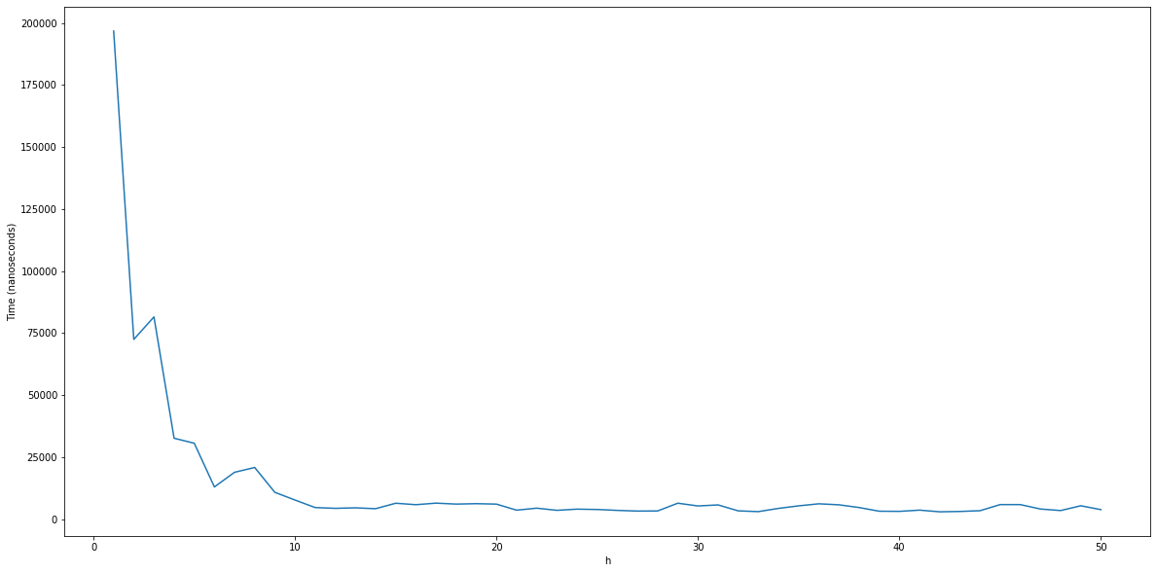
Effect of h on runtime (Part c)
Time Taken
Value of h

Slide 16
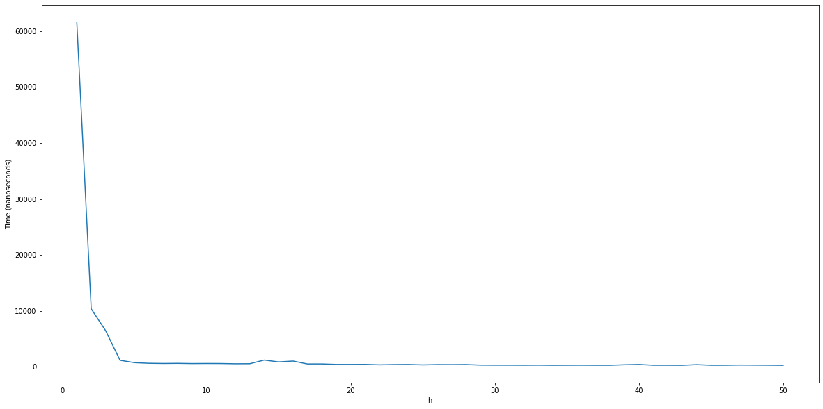
Effect of h on runtime (Part d)
Time Taken
Value of h

Slide 17
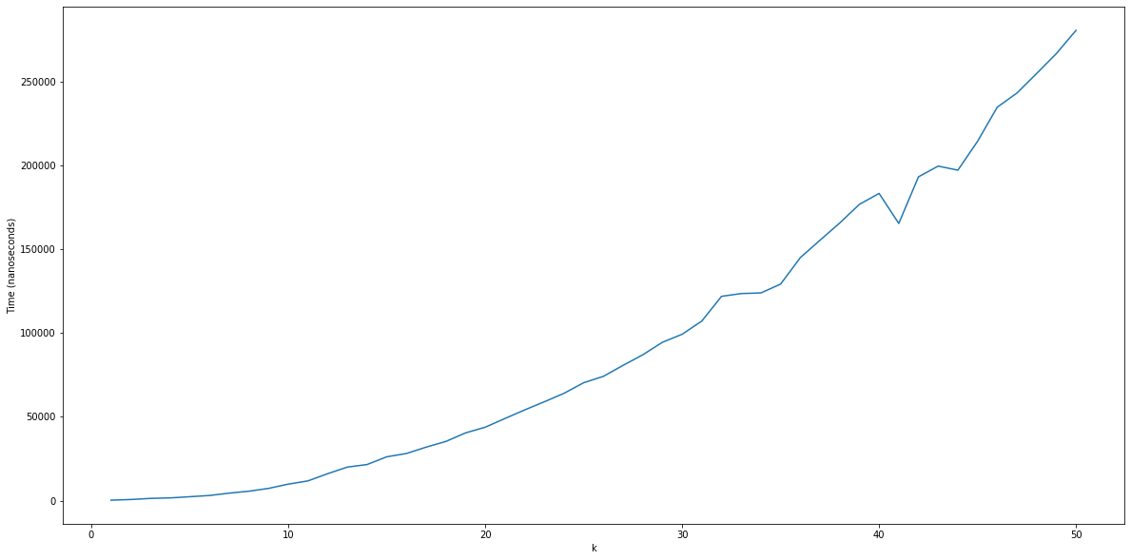
Effect of k on runtime (Part d)
Time Taken
Value of k

Slide 18
04
DEMO

Slide 19
THANK YOU

